Slide 1


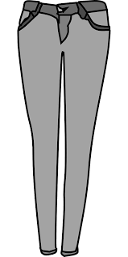
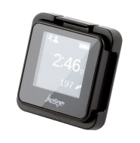
What is an activity monitor?
You have been fitted with an activity monitor (accelerometer) as part of this study. This device works by sensing your movements in several directions, allowing us to capture both the time and intensity of your activity. The device is always on, but is only activated when you move. It is safe to wear and non-invasive– the device will be attached to your body with clip that attaches to the waistband of your pants/skirt/shorts.
Directions

Slide 2
7 Day Activity log
Name: ______________________ Study ID Number: ________________
Day | 1 | 2 | 3 | 4 | 5 | 6 | 7
Date (month-day-year) e.g. May 8 2019
Time in morning that monitor was put ON
Time in evening that monitor was taken OFF
Was the monitor removed other than for shower/sleep? | YES NO | YES NO | YES NO | YES NO | YES NO | YES NO | YES NO
If circled YES, explain why the monitor was not worn and for how long. If taken off during physical activity, please describe what activity you did (e.g. I went swimming for 2 hours)
Was this a normal day? Please circle. | YES NO | YES NO | YES NO | YES NO | YES NO | YES NO | YES NO
If circled NO, please explain why this was not a normal day.
Any comments or problems? Please explain.

